Slide 1
SAT scores in NYC public schools
by ANNA

Slide 2
In this presentation I wanna talk about the SAT scores for the public schools in NYC
The data I collected was from Kaggle dataset
This dataset consists of a row for every accredited high school in New York City with its department ID number, school name, borough, building code, street address, latitude/longitude coordinates, phone number, start and end times, student enrollment with race breakdown, and average scores on each SAT test section for the 2022-2023 school year.
The columns (categories) are: School ID, School Name, Borough, Building Code, Street Address, City, State, Zip Code, Latitude, Longitude, Phone Number, Start Time, End Time, Student Enrollment, Percent White, Percent Black, Percent Hispanic, Percent Asian, Average Score (SAT Math), 'AS (SAT Reading),AS (SAT Writing), Percent Tested.

Slide 3
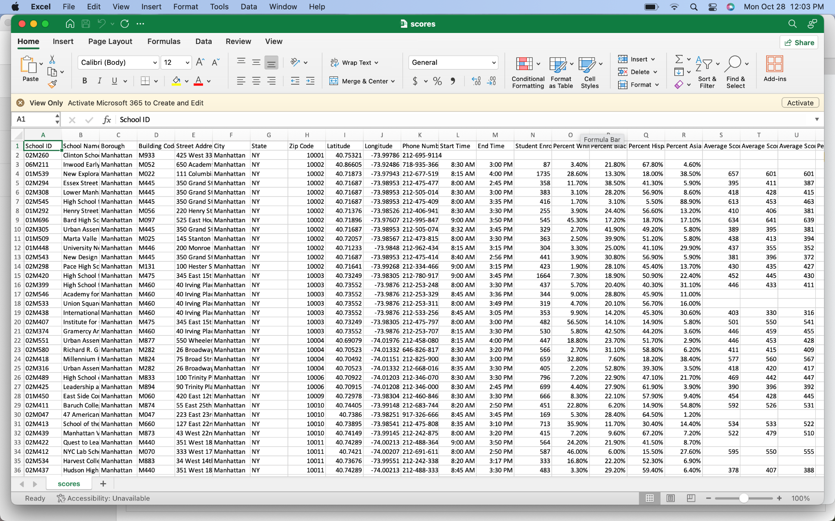
The columns (categories) are:
School ID, School Name,
Borough, Building Code,
Street Address, City,
State, Zip Code,
Latitude, Longitude,
Phone Number,
Start Time, End Time,
Student Enrollment,
Percent White, P. Black,
P. Hispanic, P. Asian,
Average Score (SAT Math),
AS (SAT Reading),
AS (SAT Writing),
Percent Tested.

Slide 4
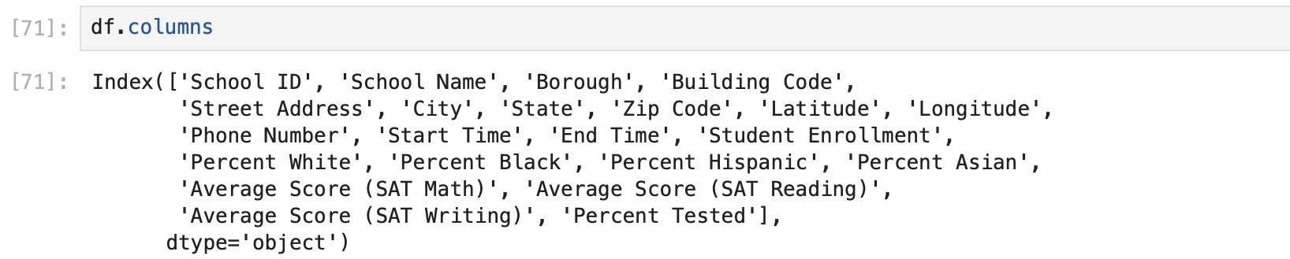
To import the dataset I’ve used our regular formula:
import pandas
df = pandas.read_csv('name_of_data_file.csv')
df
Then I made sure I was gonna read all the columns right and have them all imported in my project

Slide 5
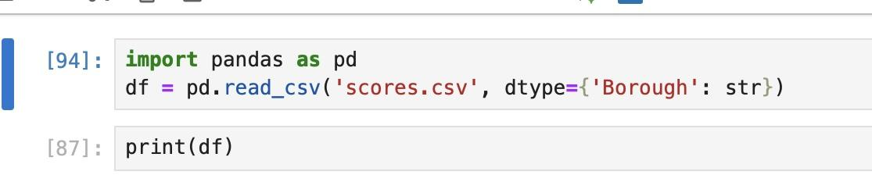
But to get the data I needed only I’ve used this formula
to narrow down most of the data that I was not gonna use
doing so I was able to go from the original 435 rows x 22 columns to just 5 rows x 22 colums

Slide 6
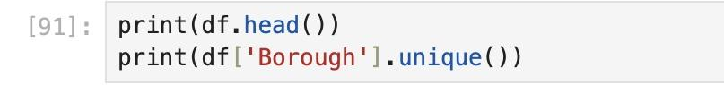
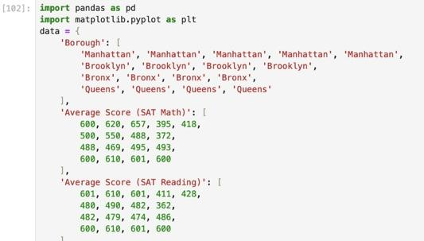
Then I read and selected random rows to use as an example for my bar graph
For then have something like this:

Slide 7
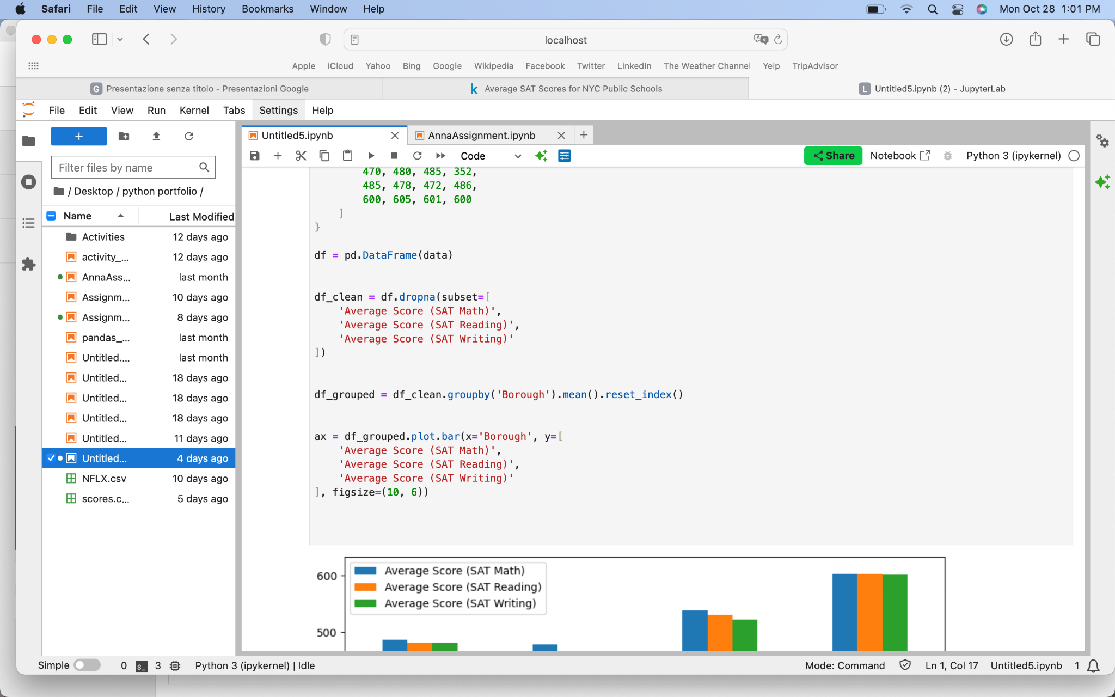
And at the end to create the graph I read this code

Slide 8
